Slide 1
Round Robin Scheduler
CSE 4300
Chetan Patel

Slide 2
CPU Scheduling

Slide 3
Preemptive vs. Non-preemptive Scheduling
Preemptive Scheduling:
Allows the operating system to interrupt a running process to allocate the CPU to another process with higher priority.
Ensures timely execution of critical tasks and responsiveness to external events but requires more complex management.
Non-preemptive Scheduling:
Processes retain control of the CPU until they voluntarily release it or enter a waiting state.
Simplifies management but may lead to potential delays in executing high-priority tasks.

Slide 4
Scheduling Algorithms
First-Come, First-Served (FCFS):
Processes are executed in the order they arrive in the ready queue.
Simple to implement but may lead to long average waiting times for processes with high burst times.
Shortest Job Next (SJN):
Executes the shortest job first to minimize average waiting time.
Can cause starvation for longer processes if a steady stream of short processes arrives.
Round Robin:
Allocates CPU time to each process in equal time slices (time quantum).
Fairly allocates CPU time but may suffer from high overhead with smaller time slices.

Slide 5
Importance of CPU Scheduling
Optimal Resource Utilization:
Ensures the CPU is actively used, preventing idle time and maximizing overall system efficiency.
Prevents overloading the CPU with too many processes, leading to system slowdowns.
Enhanced System Responsiveness:
Reduces response time by giving priority to interactive processes, resulting in a more responsive system for users.
Increased Throughput:
Maximizes the number of processes completed over a specific period, improving overall system productivity.

Slide 6
Round Robin Scheduling

Slide 7
CPU Scheduling in the Round Robin Algorithm
Overview:
CPU Scheduling: the core of multitasking in computer operating systems. The cpu scheduler determines which process runs and when it runs at any point in time
Round Robin Algorithm: a first come, first served scheduling algorithm where each process in the ready state gets the CPU for a fixed time. It cycles through the processes for a certain period of time so process has a fair chance at CPU time
Pre-emptive version of FIFO
Fairest Algorithm

Slide 8
Round Robin and Starvation
Starvation is when a process is continuously denied resources
Round Robin is Anti-Starvation
Each process is run in order of arrival time
Only runs for a predetermined slice of time (Time Quantum)
Fairness: Since each process gets its own slice of time to execute, resource hogging is prevented. (No one process can use up all the cpu time)
System is responsive to all tasks

Slide 9
Time Quantum
Time Quantum: a scheduling approach is implemented to determine the sequence in which the processes are carried out. The time quantum determines how long each process runs.
Time Quantum can vary depending on the application
#define TIME_QUANTUM 2
We arbitrarily chose a Time Quantum as 2

Slide 10
Queue

Slide 11
Node Overview
Node Structure: each node represents a process that has ‘pid’ and ‘time_passed’ for identification and tracking execution time
typedef struct Task {
int pid;
int burst_time;
int initial_bt;
int arrival_time;
int turnaround_time;
int response_time;
struct Task* next;
} Task;

Slide 12
Enqueuing Processes in the Queue
Adding a process: the new processes join the queue at ‘rear’ and wait for their turn
void enqueue(Queue *q, Task *t){
if (isEmpty(q)){
q->front = q->rear = t;
}
else{
t->next = NULL;
q->rear->next = t;
q->rear = t;

Slide 13
Dequeuing Processes in the Queue
int dequeue(Queue *q){
if (isEmpty(q)){
return -1;
}
else{
Task *temp = q->front;
int pid = temp->pid;
q->front = temp->next;
if (q->front == NULL){
q->rear = NULL;
}
return pid;
The code seen in bold removes the process at the front, simulating the end of its CPU slice.
In round robin scheduling, after a CPU slice the process gets dequeued; however, if the process has not finished executing it gets enqueued again
This allows it to run for another time slice once all other processes have run

Slide 14
Queue
Round-Robin Scheduling: In round-robin scheduling, each process is given a time quantum ( a fixed amount of time) to execute. After this allocated time, the scheduler moves onto the next process in the queue.
Process might not be done by the end and will need to be added back to the end of the queue
We need to dequeue, then enqueue again
Queue Management: The processes are put into a Ready Queue when they arrive so that they can be executed in order of arrival. Similar to First In First Out.

Slide 15
Allocating CPU Time to Processes
void enqueue(Queue *q, Task *t){
if (isEmpty(q)){
q->front = q->rear = t;
}
else{
t->next = NULL;
q->rear->next = t;
q->rear = t;
This function adds a new process to the queue. It is essential for adding processes that are newly arrived or have completed their time quantum but are not yet finished because it maintains the needed order.
int dequeue(Queue *q){
if (isEmpty(q)){
return -1;
}
else{
Task *temp = q->front;
int pid = temp->pid;
q->front = temp->next;
if (q->front == NULL){
q->rear = NULL;
}
return pid;
This function removes a process from the front of the queue, simulating the end of its CPU time slice.

Slide 16
Testing

Slide 17
Response and Turnaround Time
Turnaround Time: The amount of time it takes to complete a process
Turnaround Time in Round Robin is Relatively High
A process can finish executing in 1 time slice or multiple. If multiple it has to wait for it’s next turn after each time slice is completed.
Response Time: The amount of time it takes for the first execution of a given process to start
Response Time in Round Robin is Relatively Low
Each process only has a specific slice of time it can run before the next process is run.

Slide 18
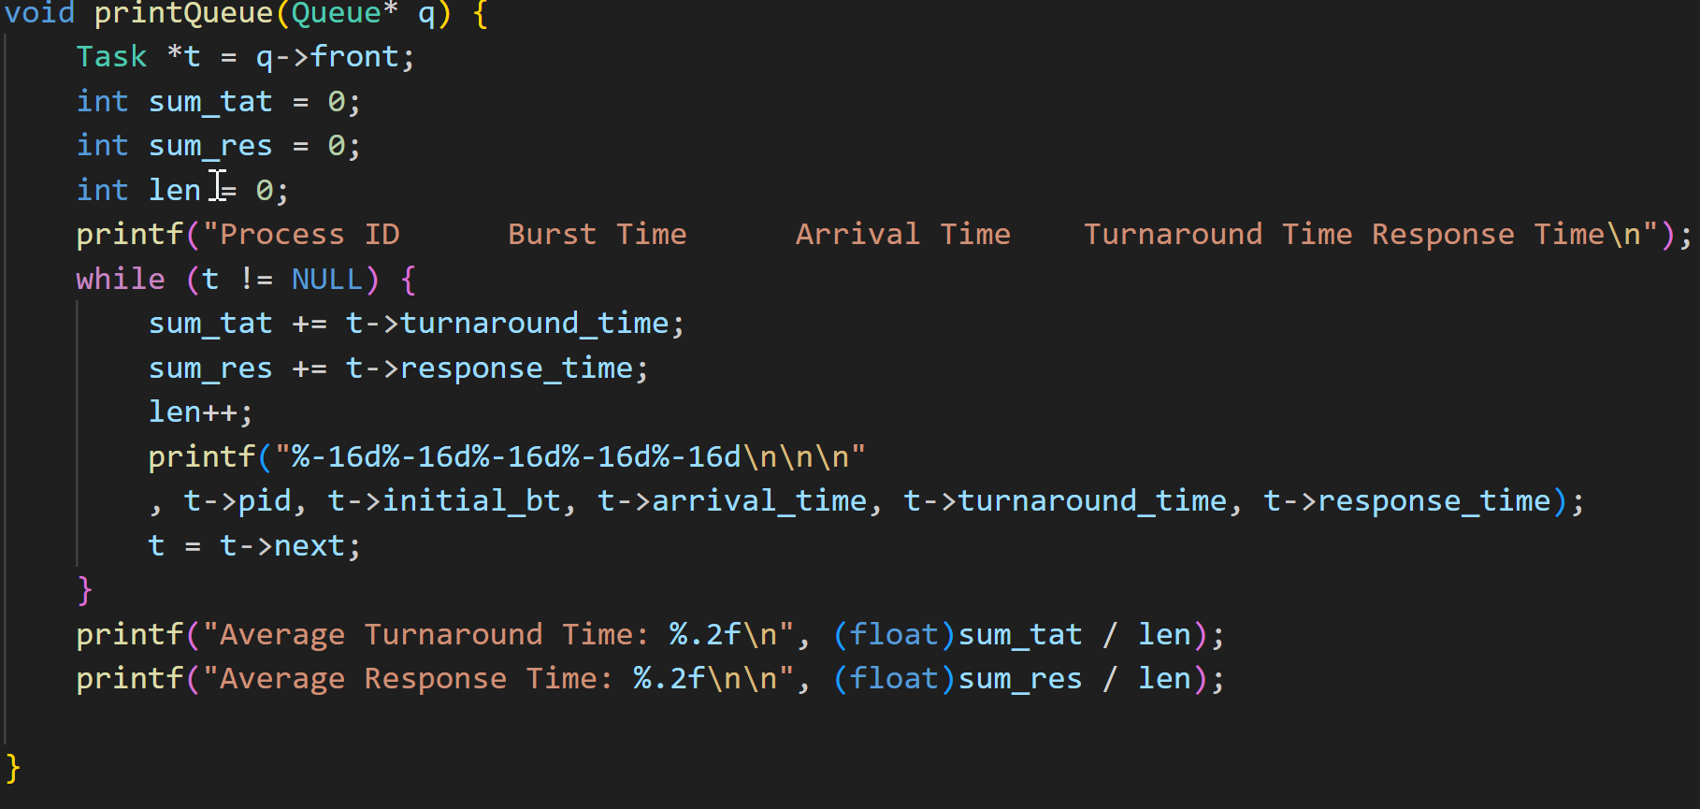
Printing the Queue
This code goes through the queue and prints the process ID, burst time, arrival time, turnaround time, and response of the processes.
Also prints the average turnaround time and average response time

Slide 19
Test
PID | Burst Time | Arrival Time
1 | 3 | 7
2 | 4 | 5
3 | 2 | 2
4 | 2 | 3
5 | 4 | 1
6 | 2 | 0
P6 | P5 | P3 | P4 | P2 | P1 | P5 | P2 | P1
2 4 6 8 10 12 14 16 17

Slide 20
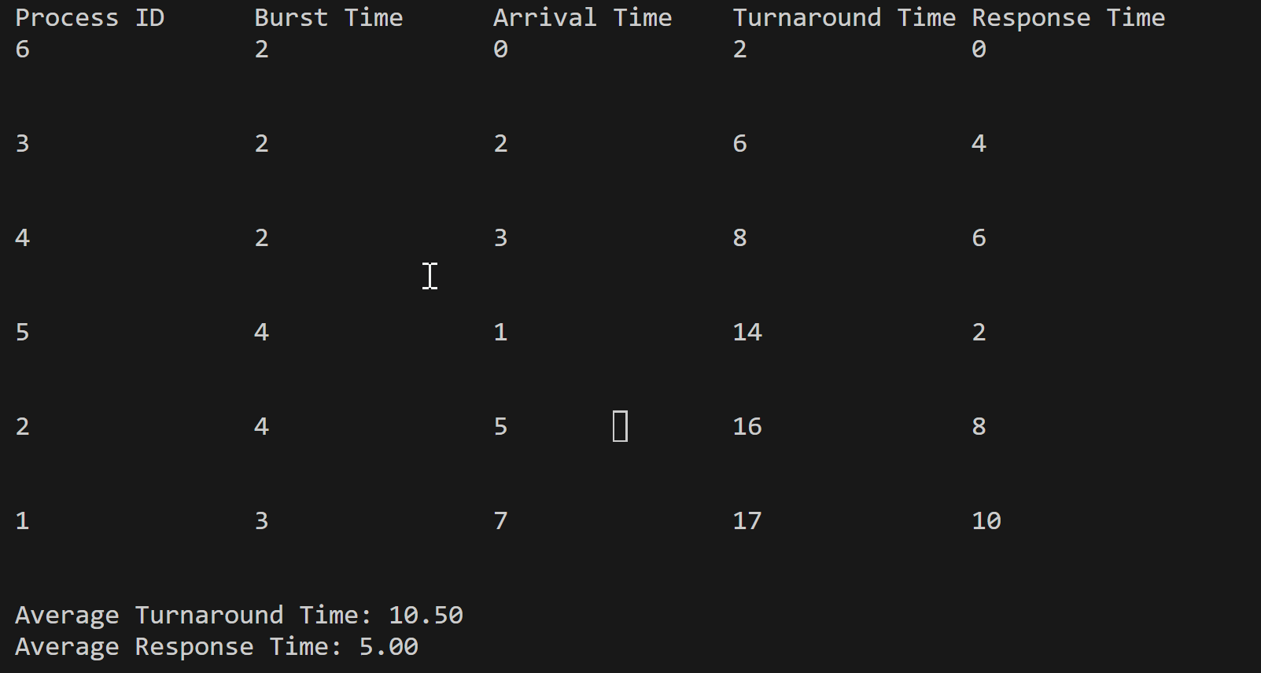
Test (Cont.)

Slide 21
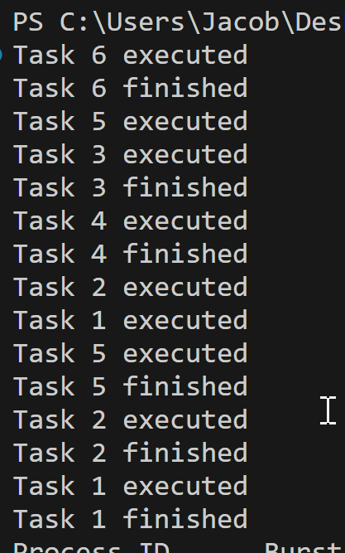
Test (Cont.)
As we can see the code ran as expected.
The example chart and lines up with how the Tasks executed.

